Slide 2
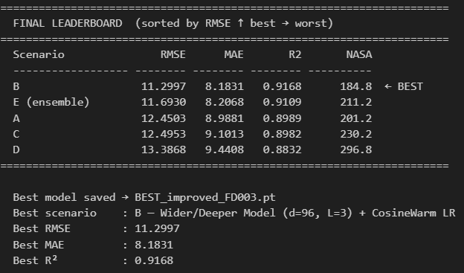
FD003 – Improved Fuse Transformer

Slide 3
